Slide 1
Support dose selection in oncology trials by predicting drug inhibition
Andy Stein, Pharmacometrics, Novartis
August 15, 2018

Slide 2
April 4, 2016

Slide 3
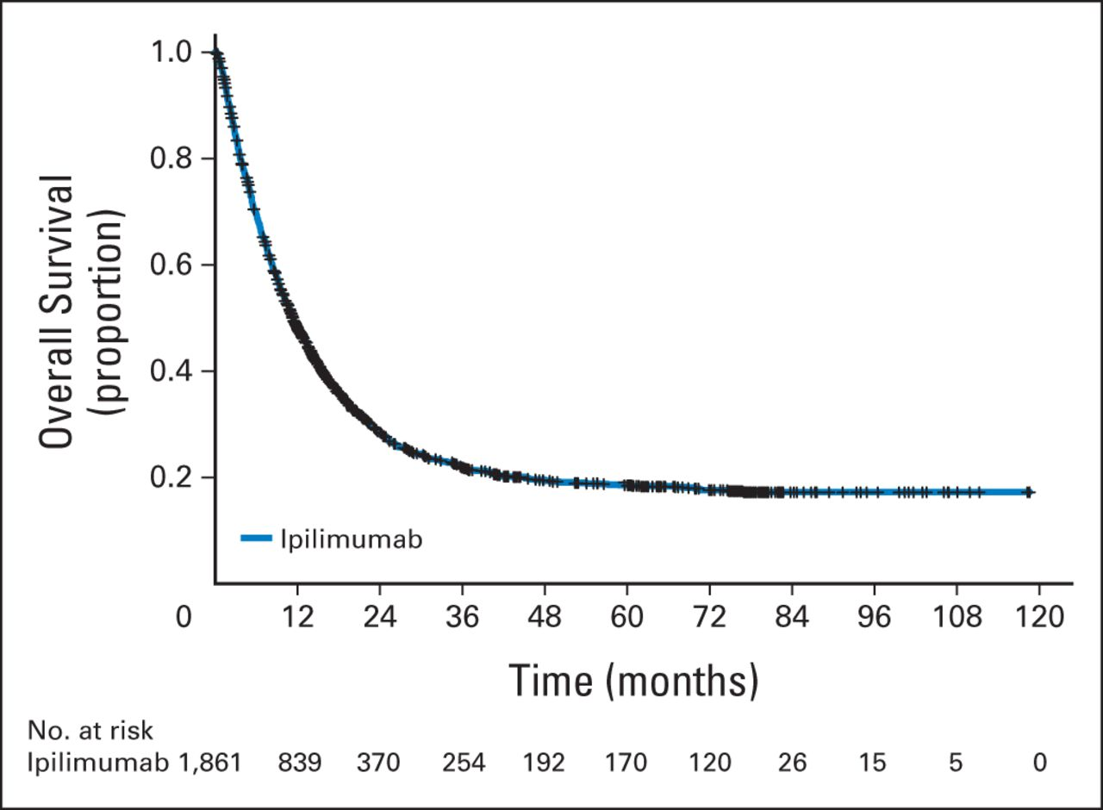

Immune therapies may be curative for some patients
Metastatic Melanoma
survival outlook 10 years ago
1 2 3 4 5 6 7 8 9 10
Time (years)
Dirk Schadendorf et al. JCO 2015;33:1889-1894

Slide 5
PD-L1 helps hide the cancer cells (droids) from the T cells (troopers)
Storm Troopers = T cells
Droids = Cancer
Obi Wan (OB-1) = PD-L1
“These aren’t the cells you’re looking for”

Slide 6
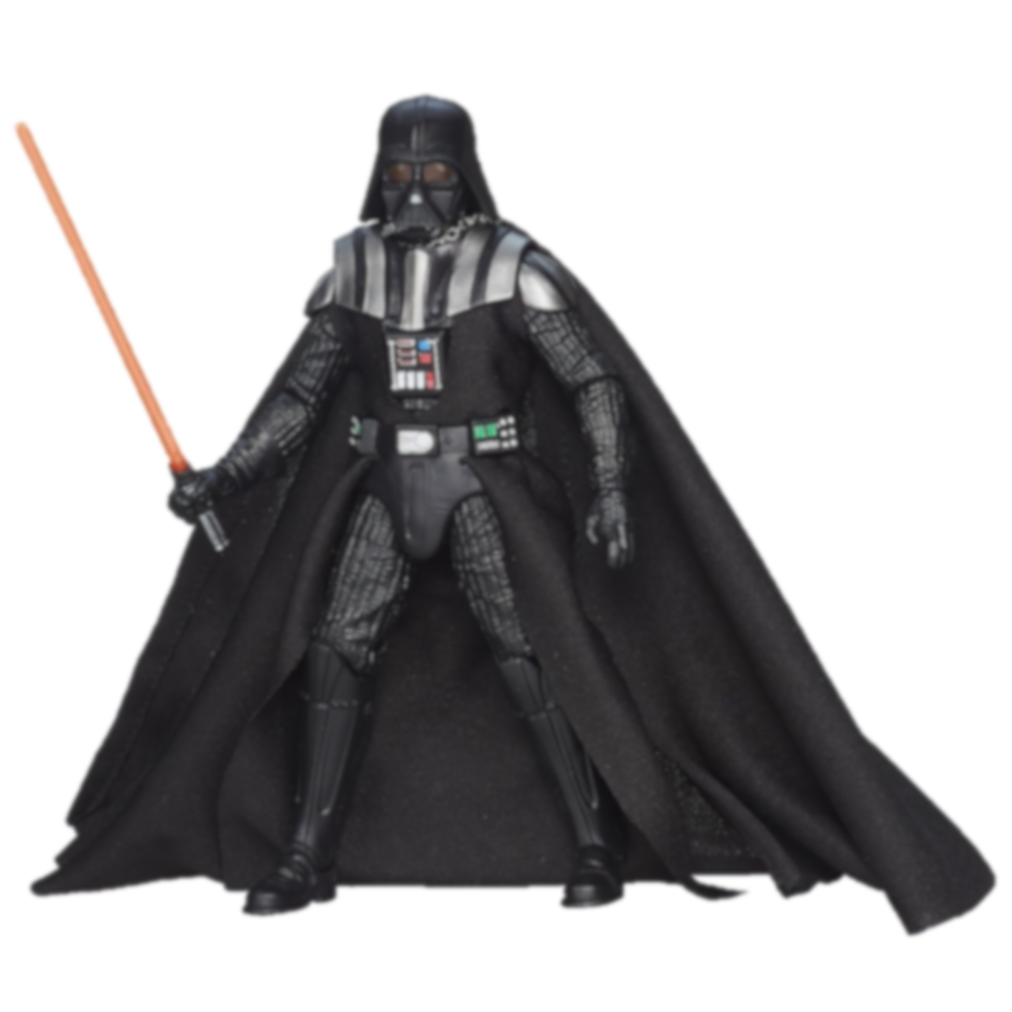
Immuno-therapy blocks PD-L1 (OB-1) so the T cells detect the cancer
Storm Troopers = T cells
Droids = Cancer
Immuno-
therapy
Obi Wan

Slide 7
How to choose the best dose of a new drug?
In clinical trials, usually you identify a dose that is:
high enough to be effective
low enough to be safe
100%
75%
50%
25%
0%
Optimal Dose
Efficacy
Adverse Event
Proportion of patients
Dose (mg)

Slide 8
How to choose a dose when available information is limited?
Immunotherapies are often relatively safe
Efficacy data is often limited in early clinical trials
Need to use additional information to choose dose
100%
75%
50%
25%
0%
Optimal Dose?
Proportion of patients
Adverse Event
Dose (mg)

Slide 9
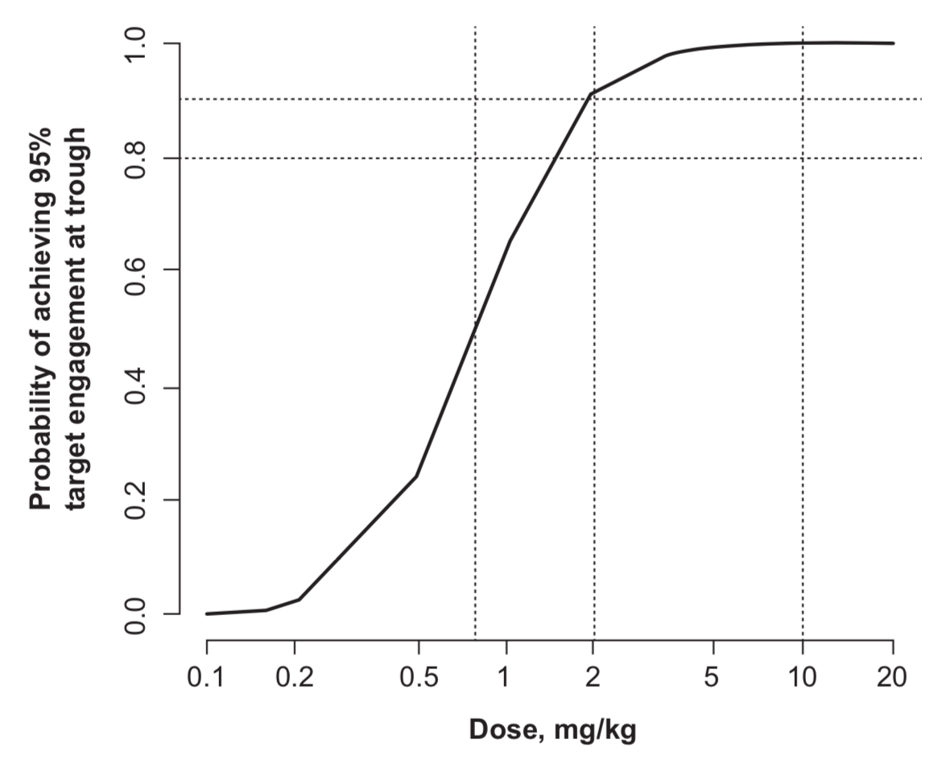
Target engagement has been used to guide dose selection¹⁻²
Anti-PD-1
Drug
PD-1
+
Probability of Achieving
95% target engagement
Drug-PD-1
Complex
Dose (mg/kg)
Deng, Rong, et al. "Preclinical pharmacokinetics, pharmacodynamics, tissue distribution, and tumor penetration of anti-PD-L1 monoclonal antibody, an immune checkpoint inhibitor." MAbs. Vol. 8. No. 3. Taylor & Francis, 2016.
Elassaiss‐Schaap, J., et al. "Using model‐based “learn and confirm” to reveal the pharmacokinetics‐pharmacodynamics relationship of pembrolizumab in the KEYNOTE‐001 Trial." CPT: pharmacometrics & systems pharmacology 6.1 (2017): 21-28.

Slide 10
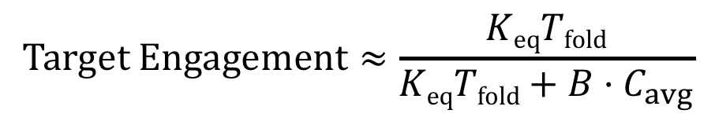
A formula exists for predicting target engagement
$$Target Engagement≈\frac{KeqTfold}{KeqTfold+B·C_{avg}}$$
K_{eq} = equilibrium binding constant
T_{fold} = fold change in target expression after binding to drug
C_{avg} = steady state average drug conc.
B = biodistribution coefficient; fraction of drug that makes it from circulation to tissue

Slide 11
Target engagement does not take into account competition with its endogenous ligand
Anti-PD-1
Drug
PD-1
PD-L1
+
+
Prevent tumor cell killing
Drug-PD-1
Complex
PD-1/PD-L1
Complex

Slide 12
Challenge for workshop
Extend potency formula to scenario where drug and endogenous ligand both bind target
Understand under which conditions the new potency factor for tumors is applicable
Perform sensitivity analyses with realistic parameters for actual drugs (tocilizumab, canakinumab, pembrolizumab, atezolizumab) to check calculations
Assess potency of marketed drugs in order to guide development of new drugs

Slide 13
Backups

Slide 14
The Quasi-Equilibrium Assumption
Assumption: binding is rapid such that drug, target, and complex stay in equilibrium.
This assumption allows us to reduce number of state variables from four [D, T, DT, D_{P}] to three [D_{tot}, T_{tot}, D_{P}] plus an algebraic set of equations

Slide 15
Quasi-Equilibrium Model
k_{syn}
Dose
D
+
T
K_{d}
DT
k₁₂
k₂₁
k_{eD}
k_{eT}
k_{eDT}
D_{P}
Dose or Synthesis
Elimination
Distribution
Concentrations D, T, and DT are solved for using
algebraic binding equations

